Slide 1
HEALTH ECONOMICS
OVERVIEW OF ECONOMIC EVALUTIONS
Patricia Nyokabi
UON- CEMA

Slide 2
Session Outline
Concept of economic evaluations – What and Why?
Types of analysis
Types of decision models
Synthesis of evidence from decision models

Slide 3
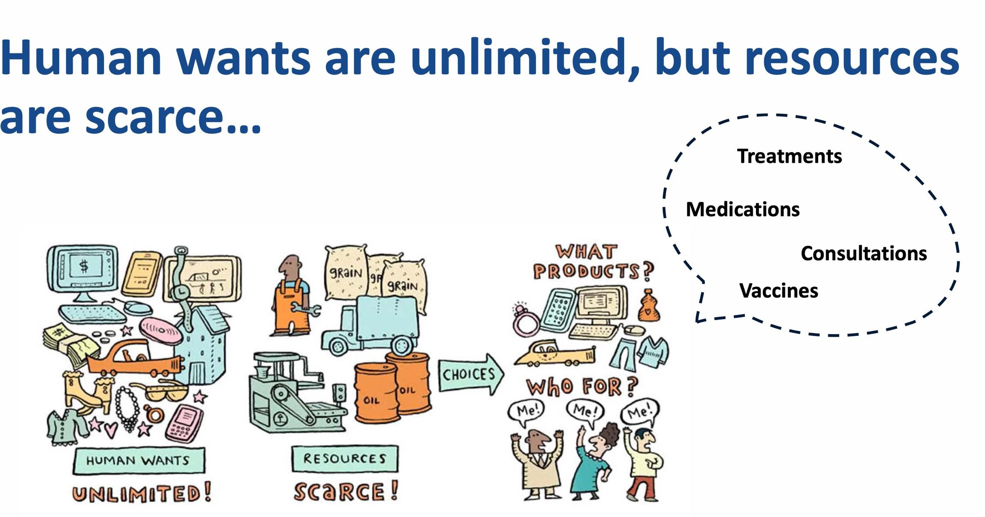

Slide 4
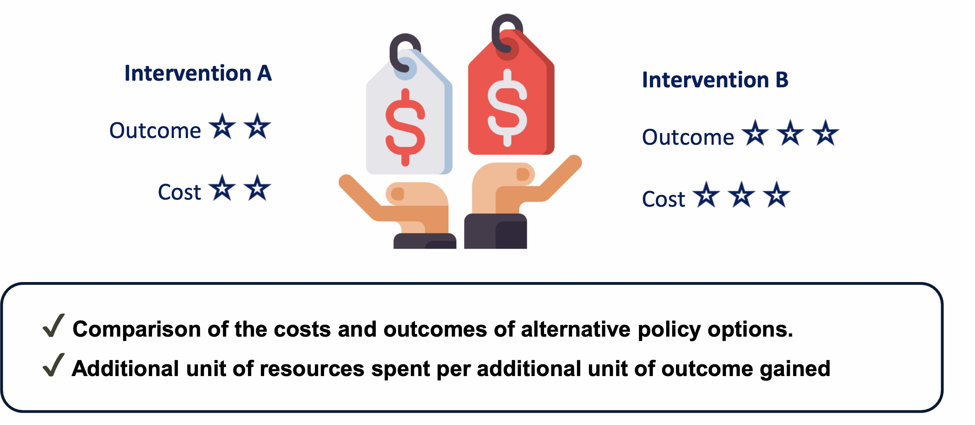
Economic evaluations

Slide 5
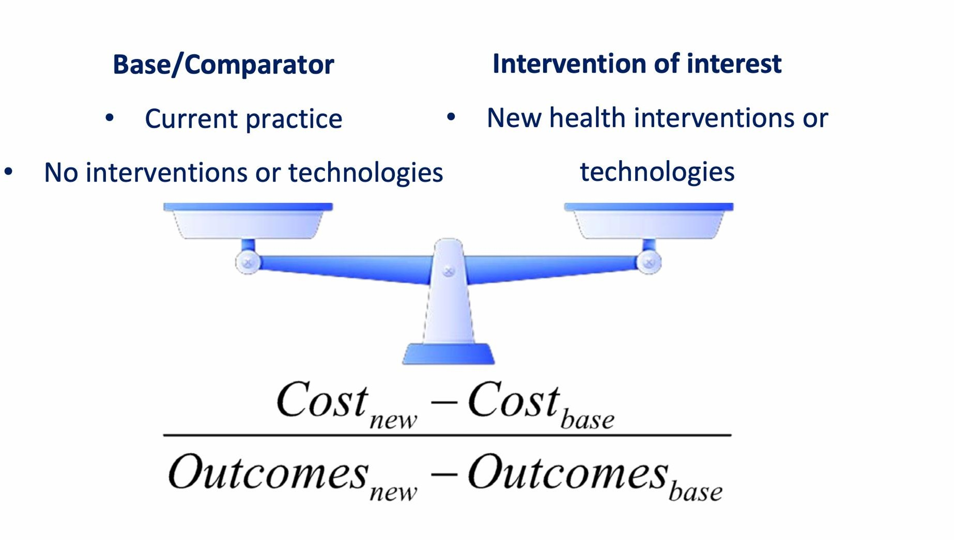
Economic evaluations

Slide 6
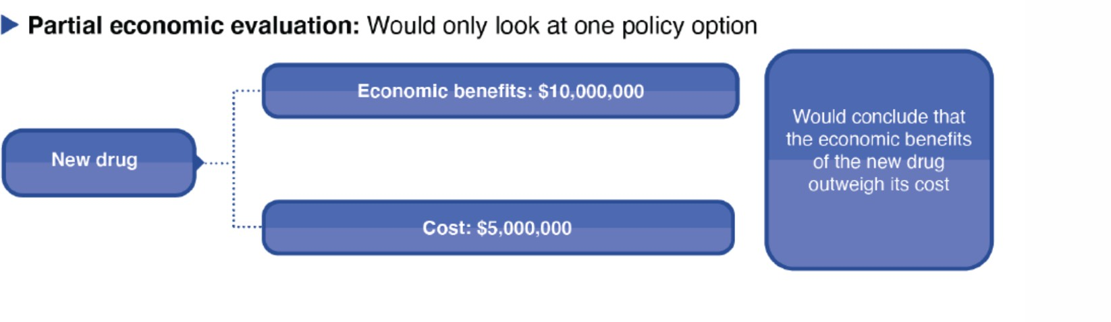
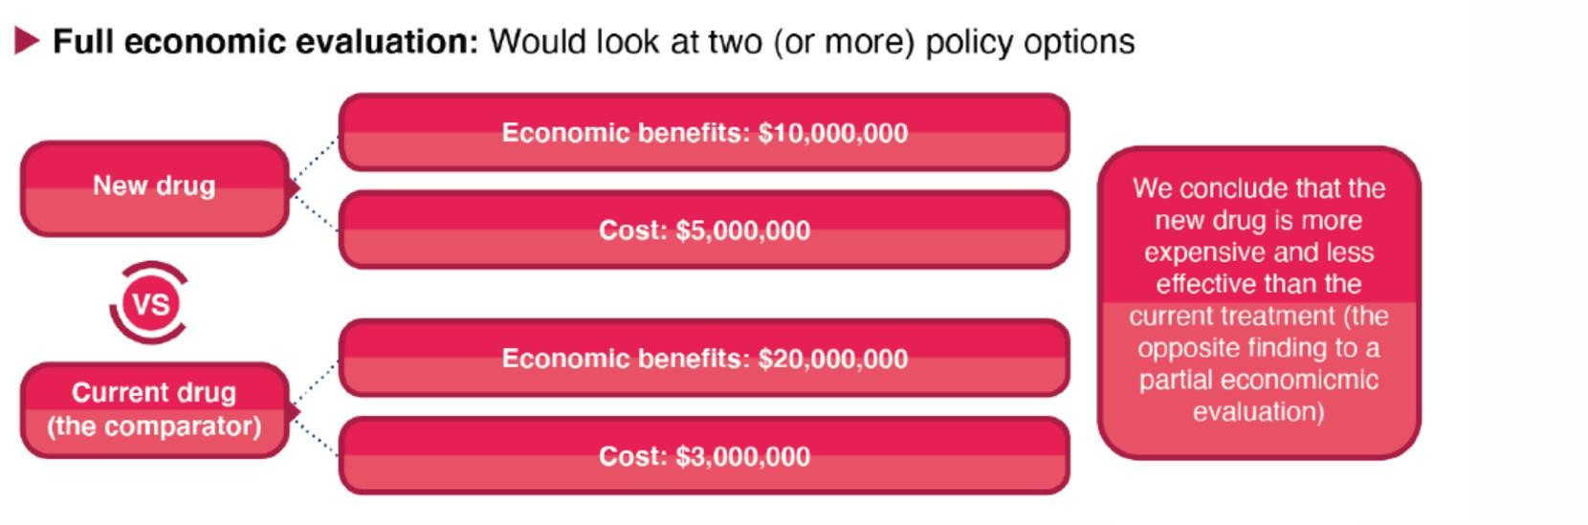
Economic evaluations
https://doi.org/10.3389/fpubh.2021.722927

Slide 7




Types of costs
Direct costs
Medical costs
Non-medical costs
Indirect costs
Productivity loss
Intangible
Monetary value of pain, suffering, distress

Slide 8

Perspectives
Societal
Provider
Payer
Patient
Sittimart, M., Rattanavipapong, W., Mirelman, A.J. et al. An overview of the perspectives used in health economic evaluations. Cost Eff Resour Alloc 22, 41 (2024).
https://doi.org/10.1186/s12962-024-00552-1

Slide 9
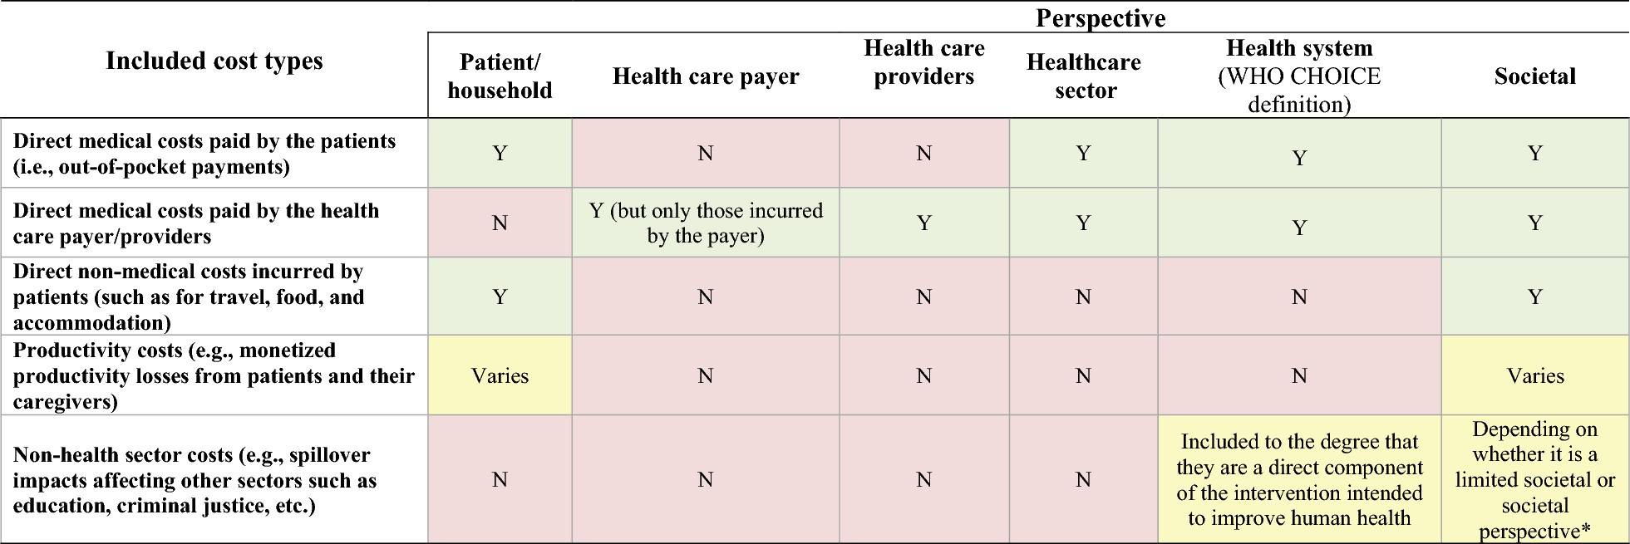
Overview of perspectives and the variation of included costs within economic evaluations
Sittimart, M., Rattanavipapong, W., Mirelman, A.J. et al. An overview of the perspectives used in health economic evaluations. Cost Eff Resour Alloc 22, 41 (2024).
https://doi.org/10.1186/s12962-024-00552-1

Slide 10
Types of economic evaluations
CMA
Minimization
CEA
Effectiveness
CUA
Utility
CBA
Benefit
10

Slide 11

Types of economic evaluations
CMA
Minimization
Same outcome
Cost per case
KES200
KES1,000
KES500
11

Slide 12
Types of economic evaluations
CMA
Minimization
Same outcome
Cost per case
Natural units
E.g., cost per kilo lost due to weight loss intervention
Cost per life-year gained, cost per case detected (ICER)
CEA
Effectiveness

Slide 13
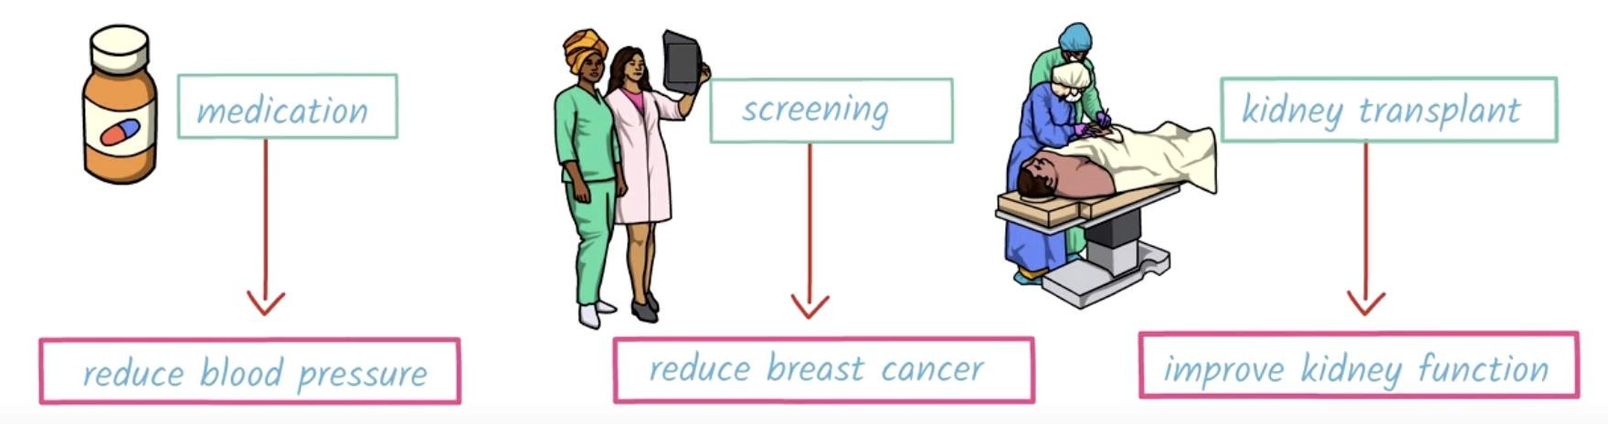
Types of economic evaluations
CMA Minimization
CEA Effectiveness
Utility
Number of years
x
Quality
CUA
QALY

Slide 14
Types of economic evaluations
CMA
Minimization
Same outcome
Cost per case
Cost per life-year gained, cost per case detected (ICER)
Cost per QALY or DALY
CEA
Effectiveness
Natural units
CUA
Utility
Utility measure
Willingness to pay Human capital
Net benefit to cost ratio
CBA
Benefit

Slide 15
Methods for economic evaluations
Alongside clinical trial | Pragmatic trial | Decision modelling
Efficacy: as part of clinical trial Cost: from trial | Effectiveness: pragmatic trial Cost: from trial | Efficacy or effectiveness and cost: systematic review and meta-analysis, survey or databases
Limitations: Number of comparators Intermediate outcome | Limitations: Number of comparators • +/- intermediate outcome | Limitations: Garbage in -- Garbage out Data availability

Slide 16
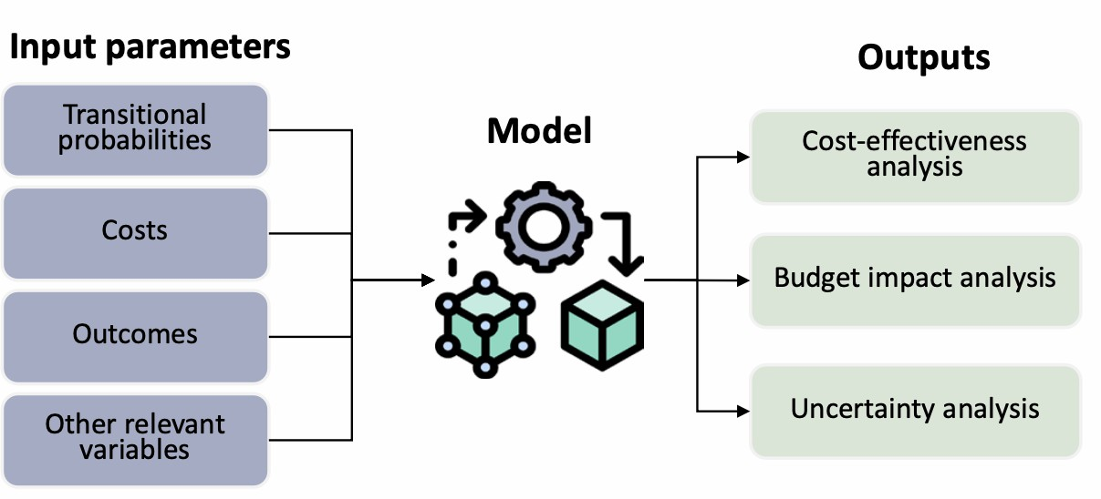
Decision models – Predict the future s reduce uncertainty
Consequences from adopting health interventions/ technologies
Tailored to the purpose for which it is to be used
Synthesise data from various sources

Slide 17
Decision models in healthcare
Your model is only as good as your data…
Your result is only as good as your modelling approach…

Slide 18
Two key considerations before we model
Cost adjustment
Time horizon

Slide 19
Cost adjustment
Past
Present
Future
Inflation
The same amount of money buys fewer goods and services in the future.
Discount rate Account for the time value of
money, which states that money available today is worth more than
the same amount in the future due to its potential earning capacity.

Slide 20
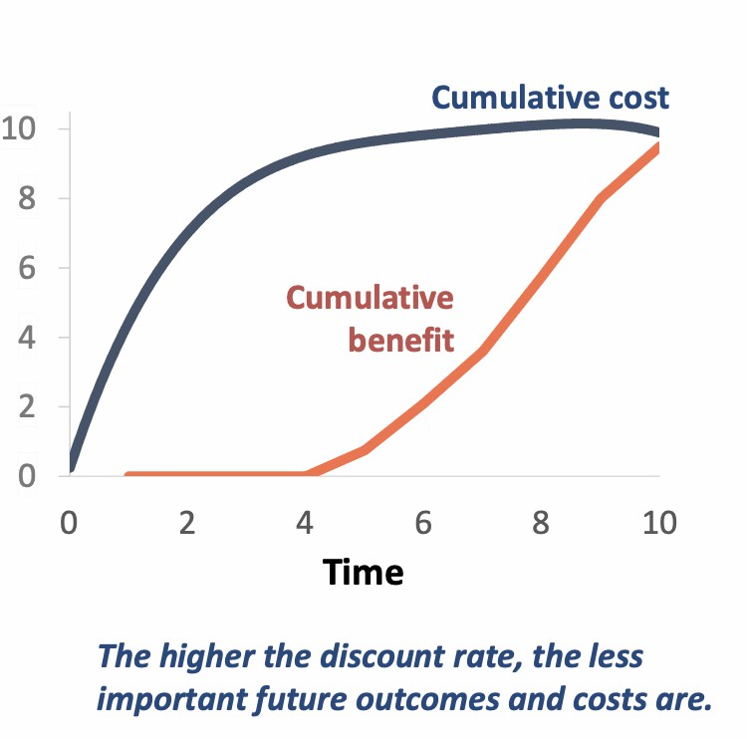
Time horizon
Determines the duration over which the outcomes and costs are calculated.
Modelling approaches may be needed to estimate outcomes that are beyond available data.
Guidelines typically recommend using a time horizon long enough to capture all relevant costs and health benefits.

Slide 21
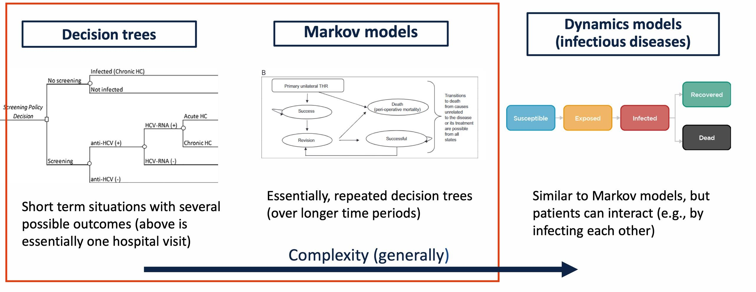
Types of decision models in healthcare

Slide 22
Choosing a decision model
Model Type | Description | Type of Decision Most Suitable For
Decision Tree Model | Diagram showing the risk of events and states of nature over a fixed time horizon | Relevant time horizon is short and fixed Acute intervention with no recurrence
Markov Model | Simulate a hypothetical cohort of individuals through a set of health states over time | For diseases/conditions that involve risk over a long time time horizon and/or recurrent events
Dynamic Model | Allowing interaction(s) between individuals | When interaction between individuals needs to be taken into account

Slide 23
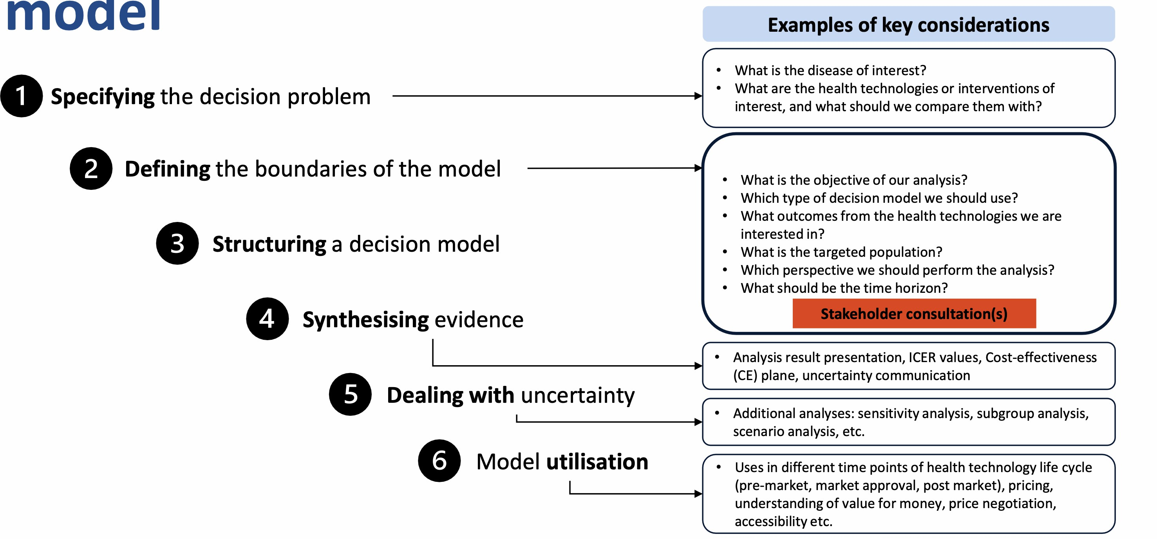
Steps for building a decision model

Slide 24
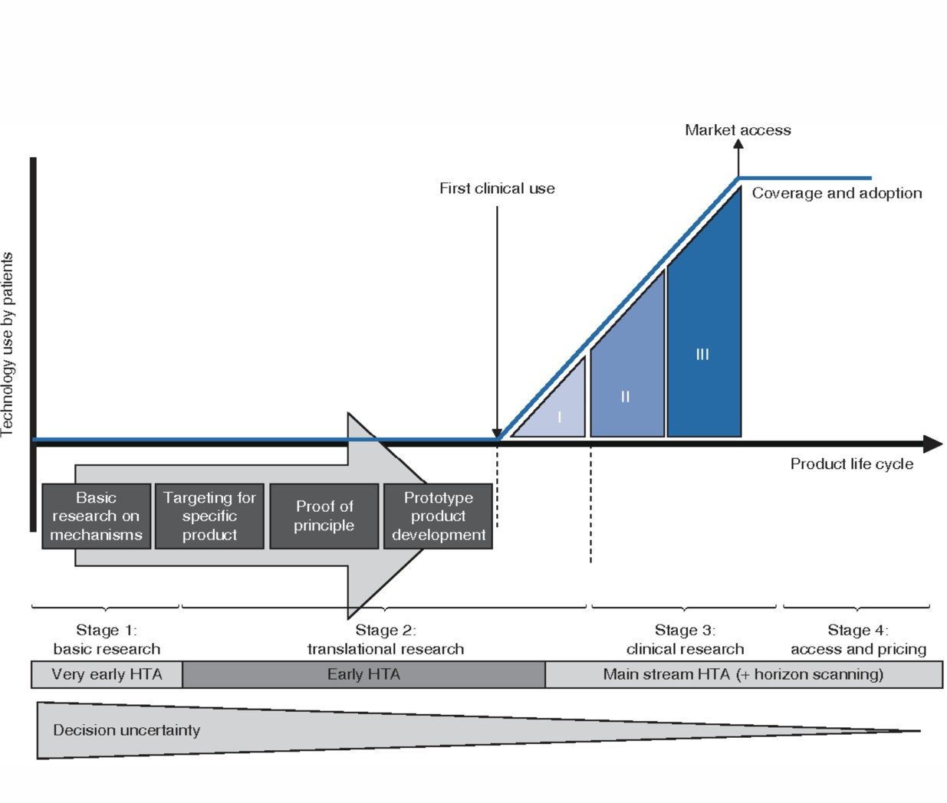
HTA Utilisation
Setting prices
Define value added
Determine important factors
Determine the value for money of health interventions
Ijzerman M.J. C Steuten L.M.G (2011) Applied Health Economics and Health
Policy volume 9, p 331–347

Slide 25
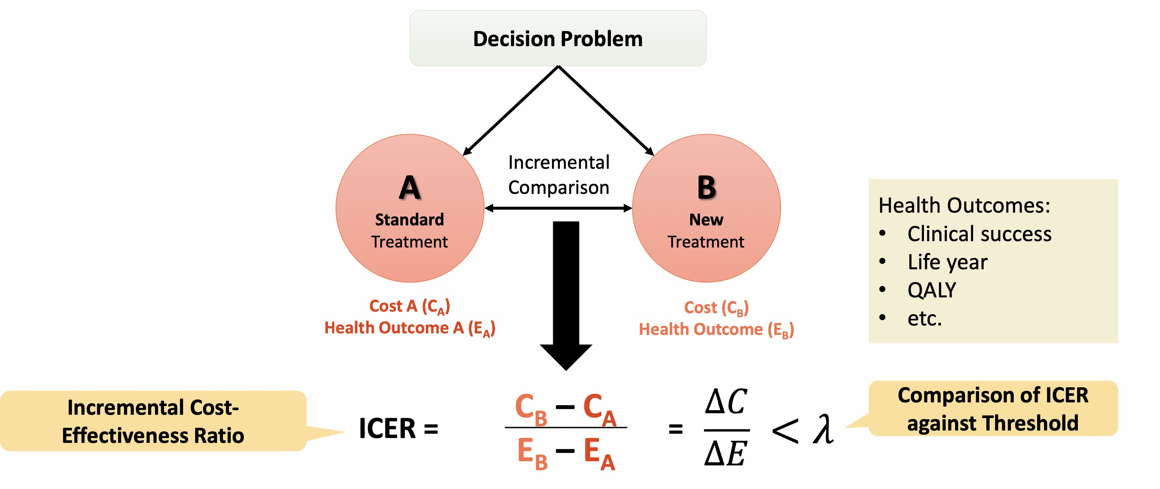
Evidence synthesis
Kenya’s cost-effectiveness threshold: US$G1G.11

Slide 26
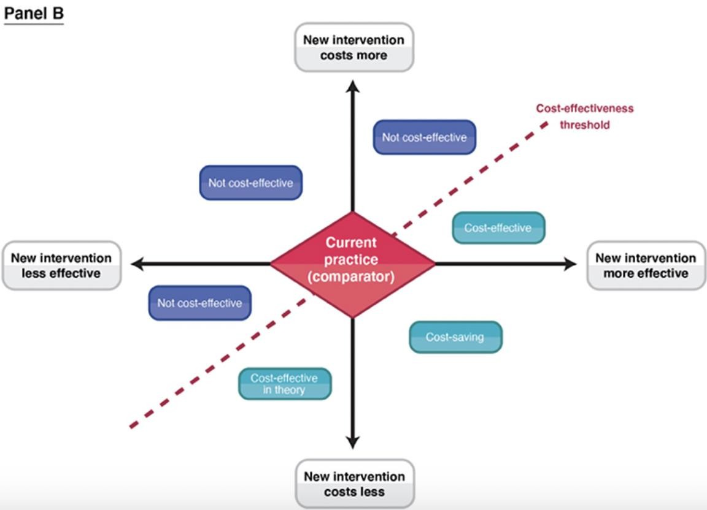
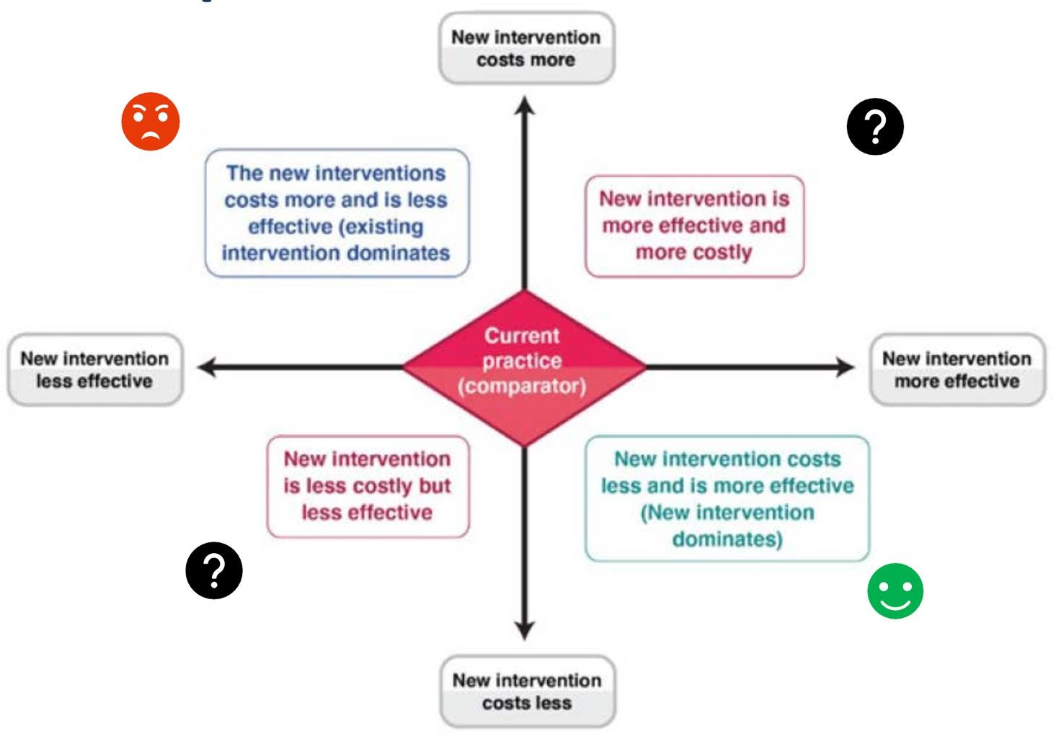
Evidence synthesis
Cost-effectiveness plane

Slide 27
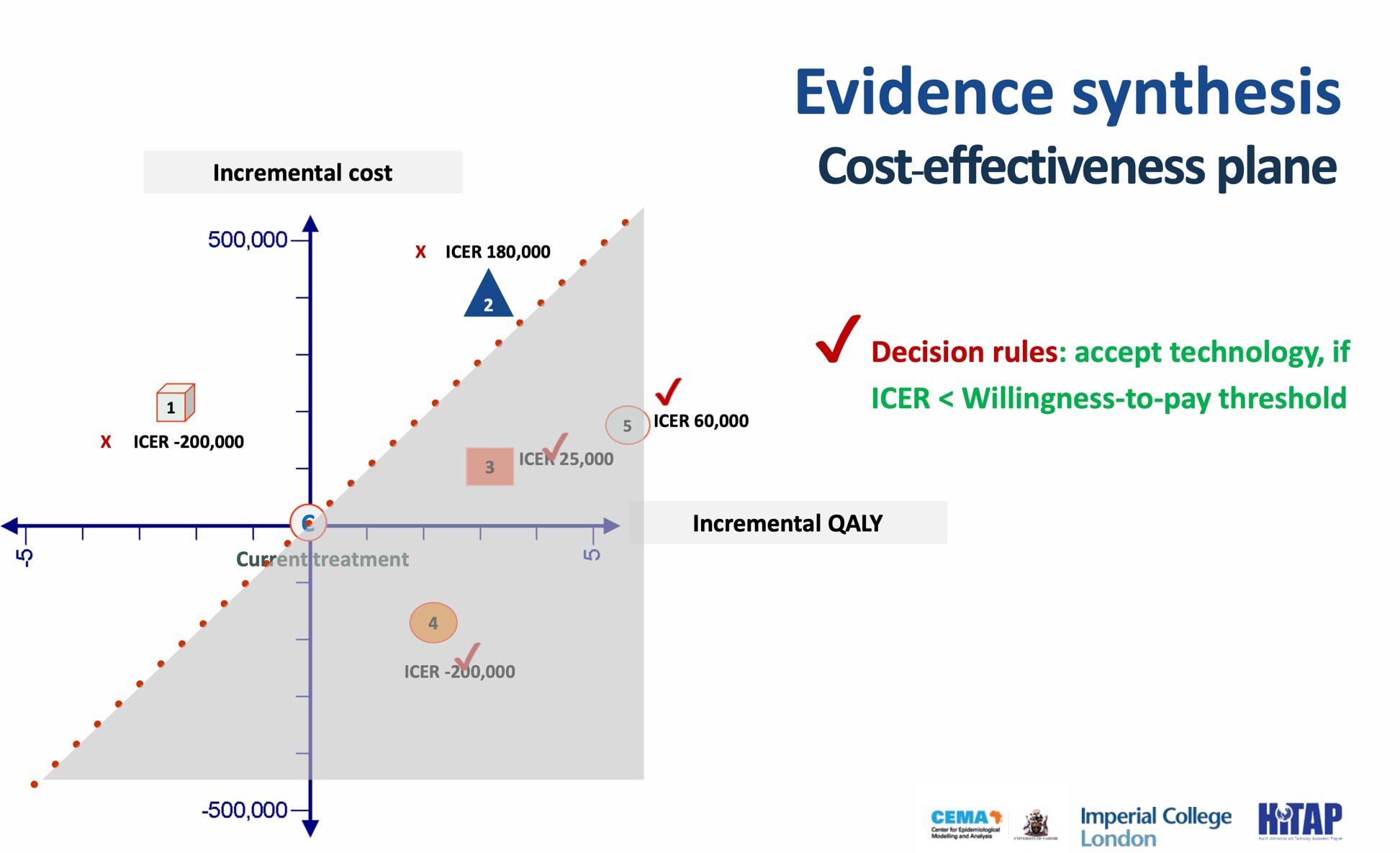
Evidence synthesis
Cost-effectiveness plane

Slide 28

The decision to introduce HPV vaccination in Kenya was not informed by a country-led economic evaluation
Value of the current GARDASIL-4 program, launched in 2019
Consider whether alternative HPV vaccines could offer better value for money

Slide 29
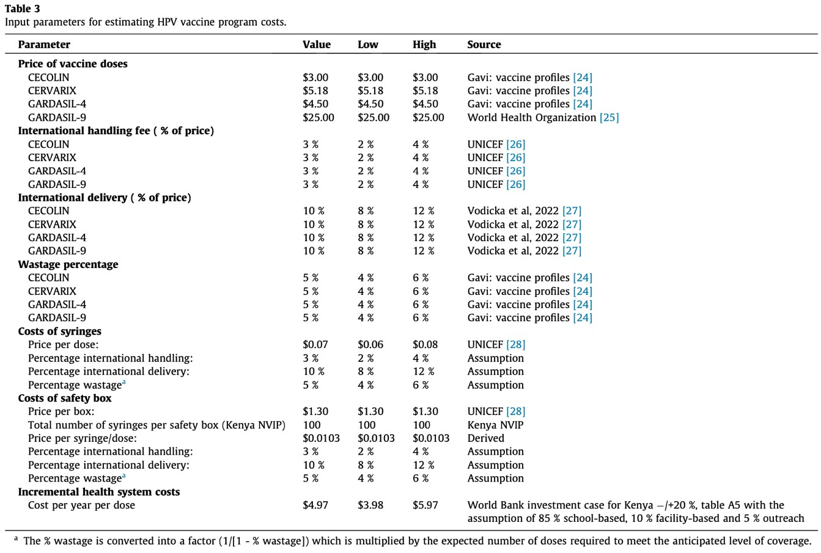
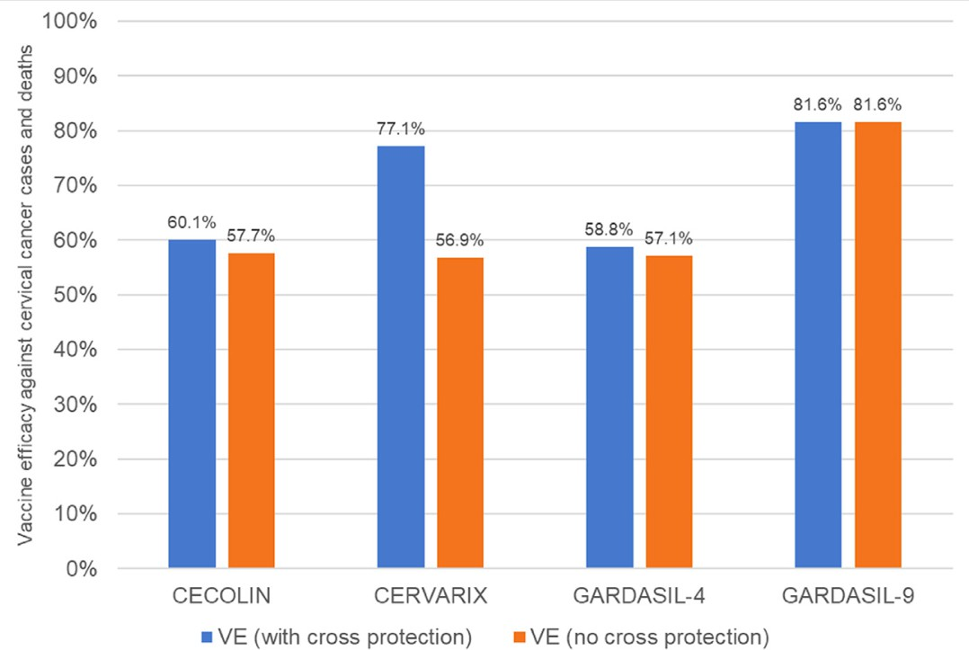

Slide 30


Slide 31
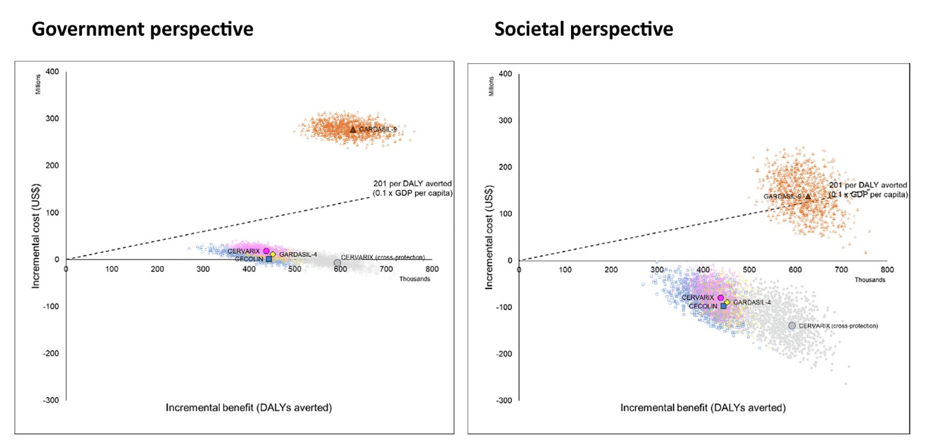

Slide 32
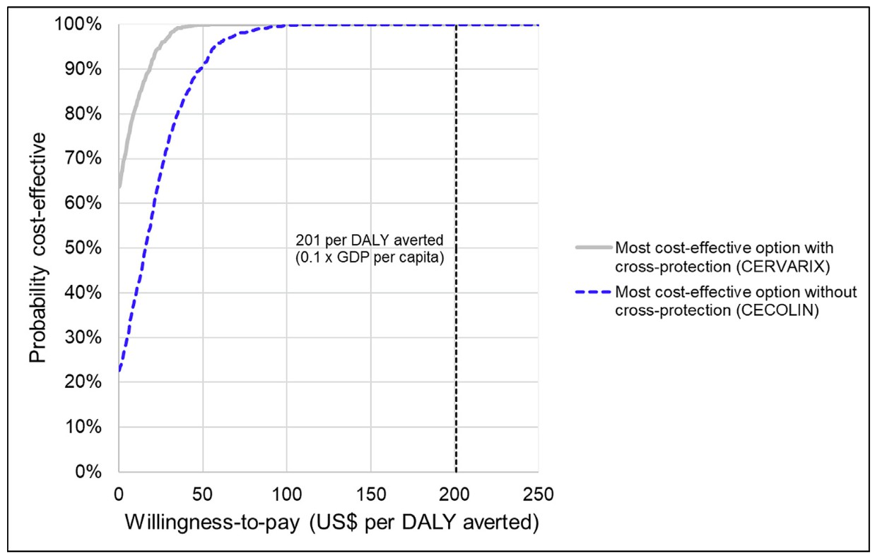

Slide 33


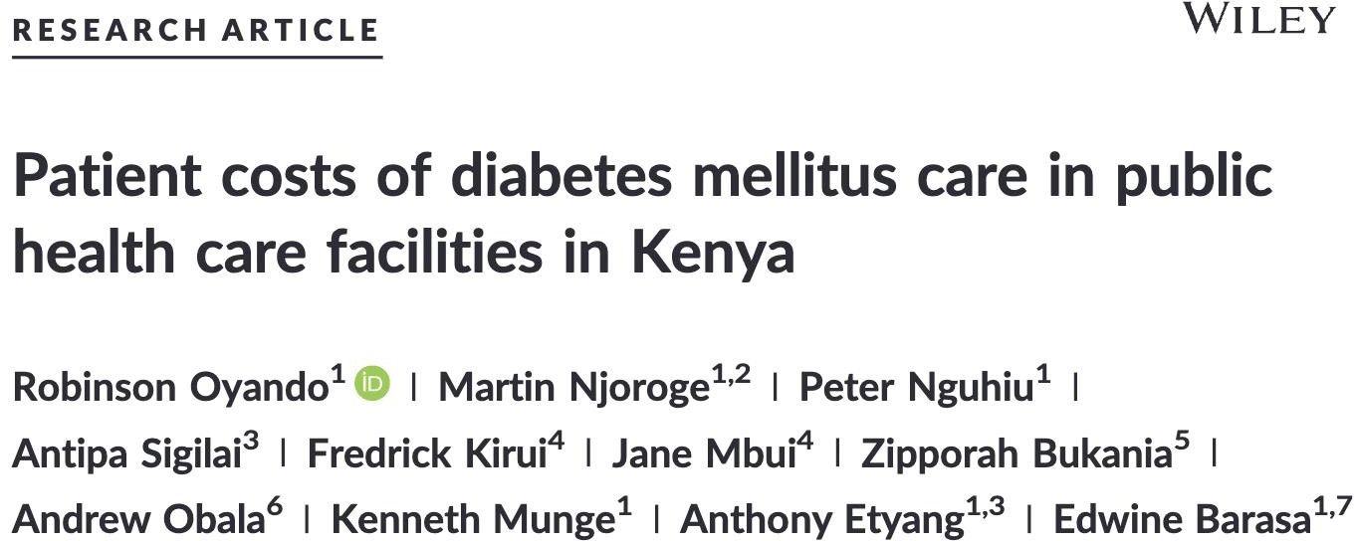

Slide 34
Further resources
Turner HC, Archer RA, Downey LE, Isaranuwatchai W, Chalkidou K, Jit M, Teerawattananon Y. An Introduction to the Main Types of Economic Evaluations Used for Informing Priority Setting and Resource Allocation in Healthcare: Key Features, Uses, and Limitations. Front Public Health. 2021 Aug 25;9:722927. doi: https://doi.org/10.3389/fpubh.2021.722927
Perspectives: Sittimart, M., Rattanavipapong, W., Mirelman, A.J. et al. An overview of the perspectives used in health economic evaluations. Cost Eff Resour Alloc 22, 41 (2024). https://doi.org/10.1186/s12962-024-00552-1
McDougall JA, Furnback WE, Wang BCM, Mahlich J. Understanding the global measurement of willingness to pay in health. J Mark Access Health Policy. 2020 Feb 15;8(1):1717030. doi: https://doi.org/10.1080/20016689
Ochalek J, Revill P, Drummond M. Allocating Scarce Resources—Tools for Priority Setting. Global Health Economics. World Scientific Series in Global Health Economics and Public Policy. vol 5. World Scientific (2018). p. 53–73. doi: https://doi.org/10.1142/9789813272378_0002
Turner HC, Lauer JA, Tran BX, Teerawattananon Y, Jit M. Adjusting for Inflation and Currency Changes Within Health Economic
Studies. Value Health. 2019 Sep;22(9):1026-1032. doi: https://doi.org/10.1016/j.jval.2019.03.021
Thompson SG, Barber JA. How should cost data in pragmatic randomised trials be analysed? BMJ. 2000 Apr 29;320(7243):1197-200. doi: https://doi.org/10.1136/bmj.320.7243.1197.
Vallejo-Torres L, García-Lorenzo B, Castilla I, Valcárcel-Nazco C, García-Pérez L, Linertová R, Polentinos-Castro E, Serrano-Aguilar P. On the Estimation of the Cost-Effectiveness Threshold: Why, What, How? Value Health. 2016 Jul-Aug;19(5):558-66. doi: https://doi.org/10.1016/j.jval.2016.02.020.
Brent RJ. Cost-Benefit Analysis versus Cost-Effectiveness Analysis from a Societal Perspective in Healthcare. Int J Environ Res Public Health. 2023 Mar 6;20(5):4637. doi: https://doi.org/10.3390/ijerph20054637.

Slide 35
Thank you!

